Slide 1
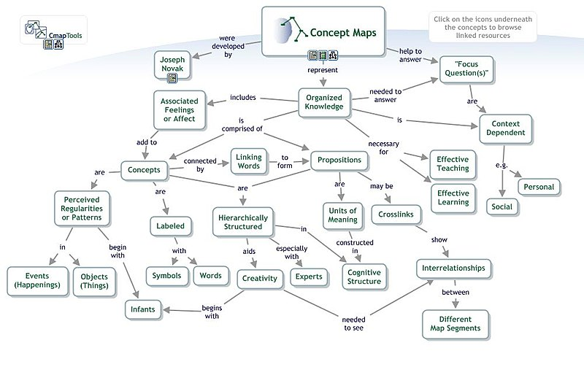
Example from https://en.wikibooks.org/wiki/Transformative_Applications_in_Education/CmapTools

